Slide 1

Java How to Program, 9/e
©1992-2012 by Pearson Education, Inc. All Rights Reserved.

Slide 2

Download JDK 17 (or any latest release): https://download.oracle.com/java/17/latest/jdk-17_windows-x64_bin.exe
Download IntelliJ IDEA : https://www.jetbrains.com/idea/download/?section=windowshttps://www.jetbrains.com/idea/download/?section=windows
©1992-2012 by Pearson Education, Inc. All Rights Reserved.

Slide 3

Visit my office for discussing
  Any topic you studied in the class
  Problems you are facing
  Any other issue for which you need counselling
Please do not ask to repeat the whole topic!
  Instead, come prepared with your specific queries: what exactly is creating problems for you and why?
Office Hours (H-17 H-Block)
Monday( 10:00 to 12 00)
Thursday( 11:30 to 1)
©1992-2012 by Pearson Education, Inc. All Rights Reserved.

Slide 4
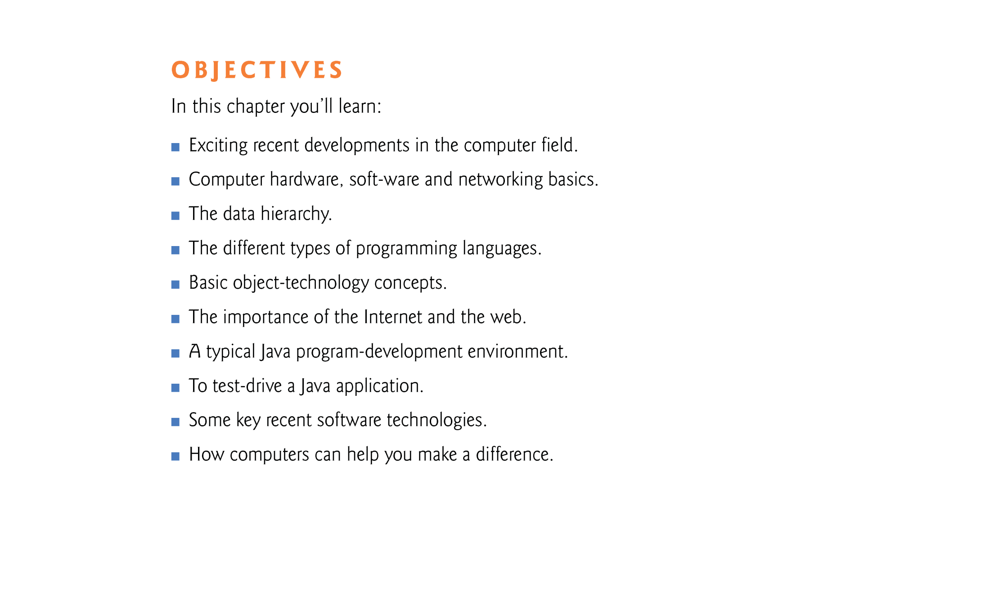
©1992-2012 by Pearson Education, Inc. All Rights Reserved.

Slide 5
©1992-2012 by Pearson Education, Inc. All Rights Reserved.

Slide 6
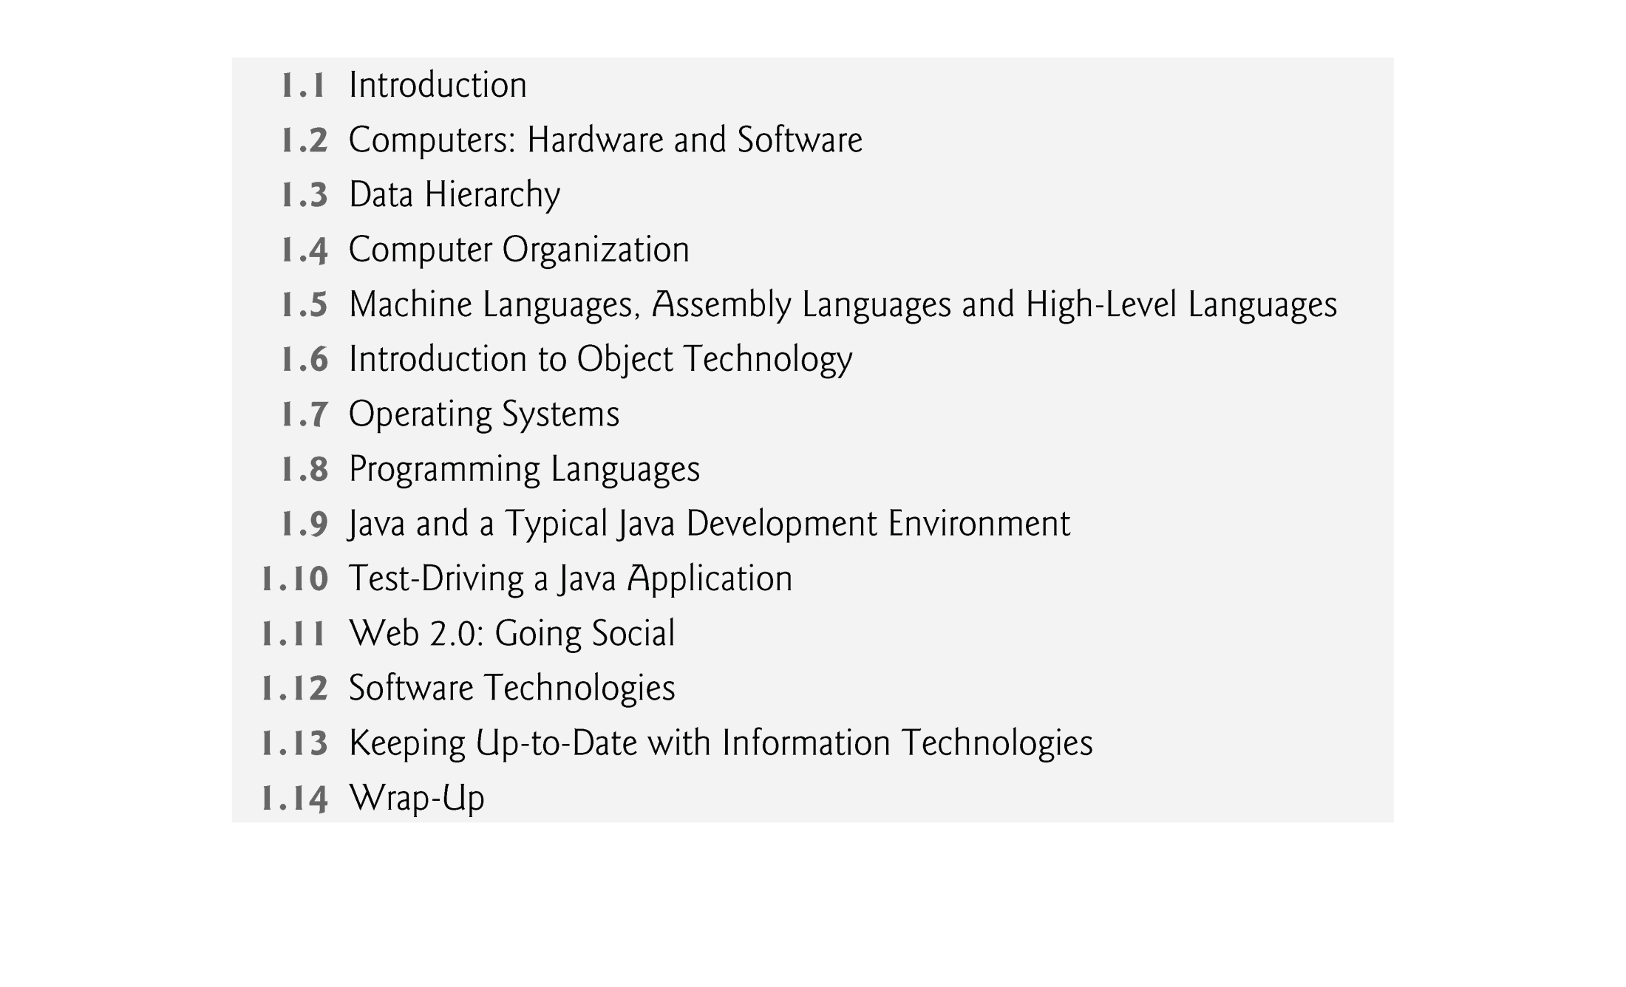
©1992-2012 by Pearson Education, Inc. All Rights Reserved.

Slide 7
©1992-2012 by Pearson Education, Inc. All Rights Reserved.

Slide 8

What is an object?
  In real world, any tangible (perceptible by touch) thing is an object.
  In software world, any tangible/intangible thing can be represented as an object.
Objects, or more precisely, the class objects, are essentially reusable software components.
  There are date objects, time objects, audio objects, video objects, automobile objects, people objects, etc.
  Almost any noun can be reasonably represented as a software object in terms of attributes (e.g., name, color and size) and behaviors (e.g., calculating, moving and communicating).
Object-oriented programs are often easier to understand, correct and modify.
©1992-2012 by Pearson Education, Inc. All Rights Reserved.

Slide 9

Example: The Automobile as an Object
  Suppose you want to drive a car to make it go faster in some direction
  The automobile object interacts with other objects like pedal, brakes, gears etc. for driving
  Pedal hides from the driver the complex mechanisms that actually make the car go faster, just as the brake hides the mechanisms that slow the car, and the steering wheel “hides” the mechanisms that turn the car.
  Such information hiding is an important characteristic of OOP
  Enables people with little or no knowledge of how engines, braking and steering mechanisms work to drive a car easily.
©1992-2012 by Pearson Education, Inc. All Rights Reserved.

Slide 10
  Before you can drive a car, it must be built from the engineering drawings that describe it.
    Drawing – class
    Build – create an object
    Car – object
©1992-2012 by Pearson Education, Inc. All Rights Reserved.

Slide 11
  A completed car has an accelerator pedal to make the car go faster, but even that’s not enough—the car won’t accelerate on its own, so the driver must press the pedal to accelerate the car.
Methods and Classes
  Performing a task in a program requires a method.
  The method houses the program statements that actually perform its tasks.
  Hides these statements from its user, just as the accelerator pedal of a car hides from the driver the mechanisms of making the car go faster.
  In Java, we create a program unit called a class to house the set of methods that perform the class’s tasks.
  A class is similar in concept to a car’s engineering drawings, which house the design of an accelerator pedal, steering wheel, and so on.
©1992-2012 by Pearson Education, Inc. All Rights Reserved.

Slide 12
Instantiation
  Just as someone has to build a car from its engineering drawings before you can actually drive a car, you must build an object of a class before a program can perform the tasks that the class’s methods define.
  An object is then referred to as an instance of its class.
©1992-2012 by Pearson Education, Inc. All Rights Reserved.

Slide 13
Reuse
  Just as a car’s engineering drawings can be reused many times to build many cars, you can reuse a class many times to build many objects.
    This is analogous to creating a function once and calling it many times with different arguments to reuse it.
  Reuse of existing classes when building new classes and programs saves time and effort.
  Reuse also helps you build more reliable and effective systems, because existing classes and components often have gone through extensive testing, debugging and performance tuning.
  Reusable classes are crucial to the software revolution that has been made possible by object technology.
©1992-2012 by Pearson Education, Inc. All Rights Reserved.

Slide 14
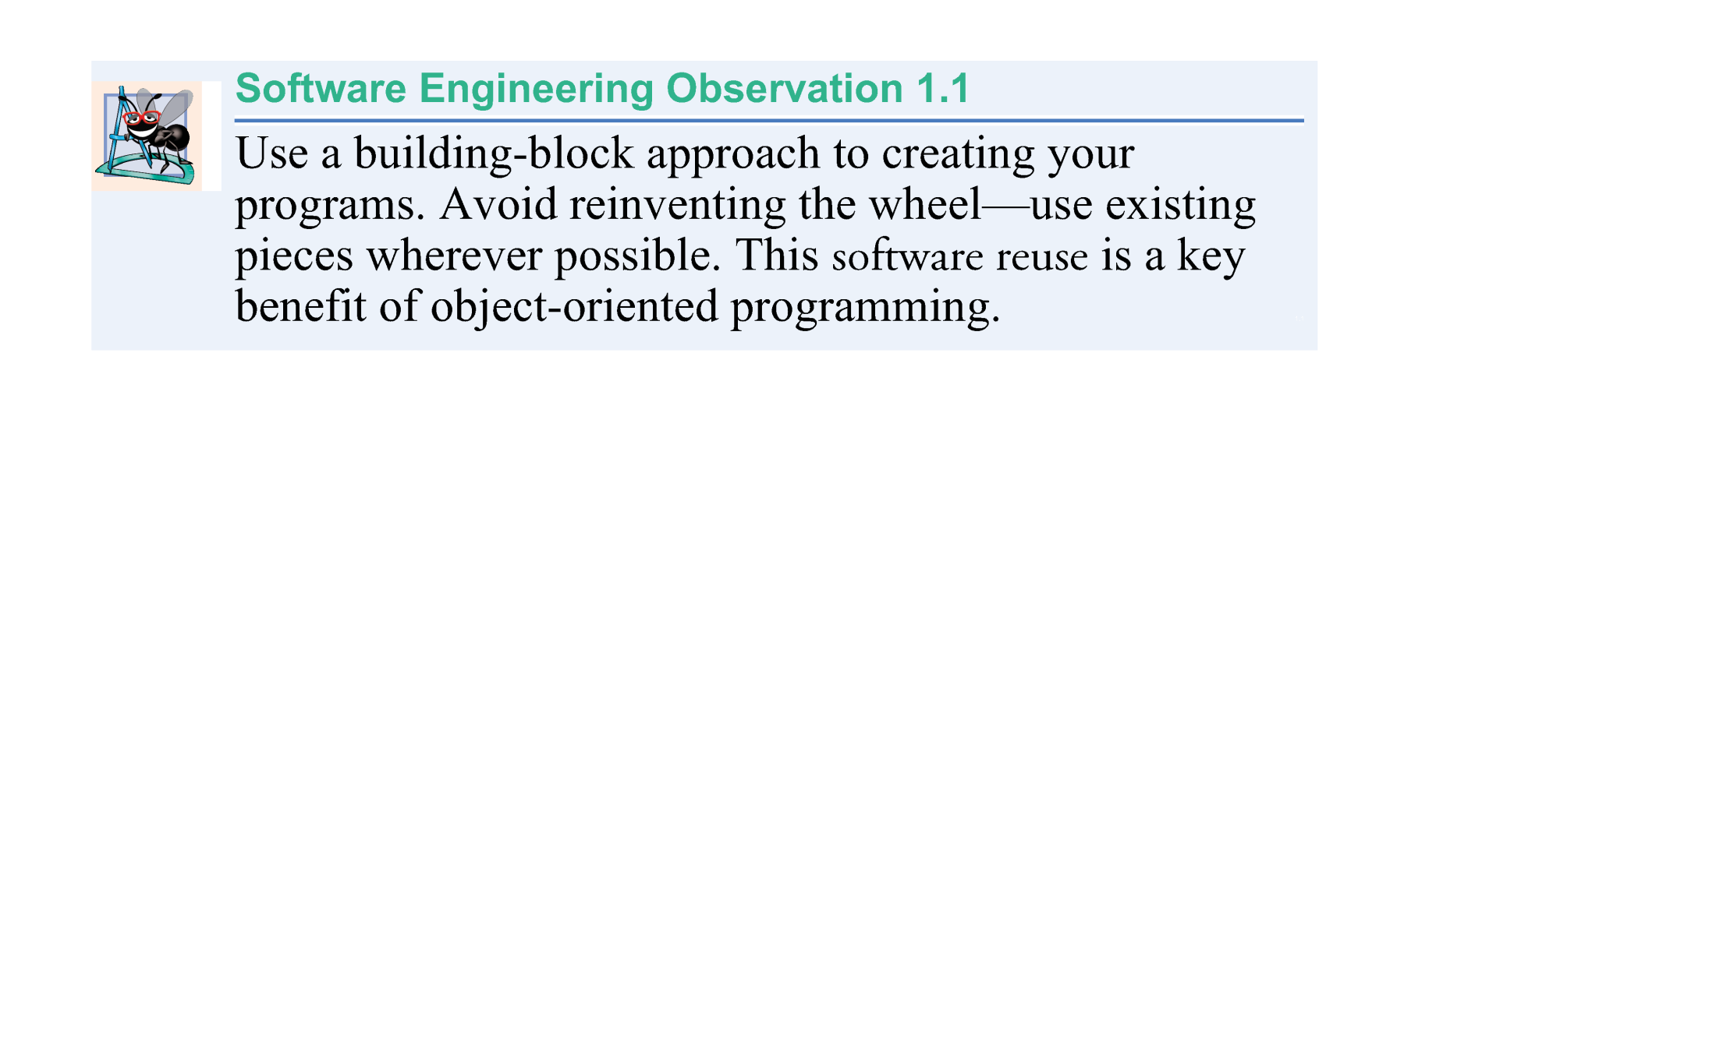
©1992-2012 by Pearson Education, Inc. All Rights Reserved.

Slide 15
Messages and Methods Calls
  When you drive a car, pressing its gas pedal sends a message to the car to perform a task—that is, to go faster.
  Similarly, you send messages to an object.
  Each message is implemented as a method call that tells a method of the object to perform its task.
©1992-2012 by Pearson Education, Inc. All Rights Reserved.

Slide 16
Attributes and Instance Variables
  Any feature of an object is called its attribute.
  A car has attributes
    Color, its number of doors, current amount of gas in its tank, its current speed, maximum speed and its record of total miles driven (i.e., its odometer reading).
  Every car has its own attributes.
    Car 1 has red color, 1000cc engine capacity.
    Car 2 has black color; 1300cc engine capacity.
©1992-2012 by Pearson Education, Inc. All Rights Reserved.

Slide 17
Encapsulation
  Classes encapsulate (i.e., wrap) attributes and methods into objects—an object’s attributes and methods are intimately related. You have to swallow this capsule altogether (as a whole and not in isolation) to get something done.
  Objects may communicate with one another, but they’re normally not allowed to know how other objects are implemented—implementation details are hidden within the objects themselves.
  This Abstraction or Information hiding, as we’ll see, is crucial to good software engineering.
©1992-2012 by Pearson Education, Inc. All Rights Reserved.

Slide 18

In Object-Oriented Programming (OOP),
👉 Object implementation refers to the way an object’s data (attributes) and behaviors (methods/functions) are actually defined and coded inside a class.
In other words:
A class is just a blueprint (like an architect’s design).
An object is an actual instance created from that blueprint.
Object implementation is about how we write the code that gives the object its structure (fields/properties) and its functionality (methods).
©1992-2012 by Pearson Education, Inc. All Rights Reserved.

Slide 19
Inheritance
  Perhaps the most important but simple concept in OOP
  A new class of objects can be created quickly and conveniently by inheritance—the new class absorbs the characteristics of an existing class, possibly customizing them and adding unique characteristics of its own.
  In our car analogy, an object of class “convertible” certainly is an object of the more general class “automobile,” but more specifically, the roof can be raised or lowered.
©1992-2012 by Pearson Education, Inc. All Rights Reserved.

Slide 20
Object-Oriented Analysis and Design (OOAD)
  How will you create the code (i.e., the program instructions) for your programs?
  Follow a detailed analysis process for determining your project’s requirements (i.e., defining what the system is supposed to do)
  Develop a design that satisfies them (i.e., deciding how the system should do it).
  Carefully review the design (and have your design reviewed by other software professionals) before writing any code.
©1992-2012 by Pearson Education, Inc. All Rights Reserved.

Slide 21
  Analyzing and designing your system from an object-oriented point of view is called an object-oriented analysis and design (OOAD) process.
  Languages like Java are object oriented.
  Object-oriented programming (OOP) allows you to implement an object-oriented design as a working system.
©1992-2012 by Pearson Education, Inc. All Rights Reserved.

Slide 22
The UML (Unified Modeling Language)
  The Unified Modeling Language (UML) is the most widely used graphical scheme for modeling object-oriented systems.
  More to come soon about UML
+------------------+
| Car |
+------------------+
| - brand: String |
| - speed: int |
+------------------+
| + drive(): void |
| + brake(): void |
+------------------+
©1992-2012 by Pearson Education, Inc. All Rights Reserved.

Slide 23

Object-Oriented Programming helps in modeling real-world scenarios.
    - Objects as real-world entities
    - Classes as blueprints
    - Methods as actions
It allows us to create a more intuitive and structured representation of the world around us.

Slide 24

Code reusability is one of the major advantages of OOP.
  - Classes can be reused in different projects
  - Inheritance allows extension of existing classes
This reduces development time and increases productivity.

Slide 25

Code written in an object-oriented paradigm is.
  Modular
  Less prone to errors
  Easier to debug
  Easier to modify and extend
This reduces development time and increases productivity (although OOP requires more boilerplate code.

Slide 26

1. Encapsulation: Bundling of data and methods
2. Abstraction: Hiding complex reality
3. Inheritance: Acquiring properties and methods
4. Polymorphism: Many shapes, one interface
These features make code more modular, easier to manage, debug, and scale.

